Slide 1
Registered report replication of cognitive dissonance
Bjørn Sætrevik
Notes:
An ongoing reseach project (reporting stage)

Slide 2
Agenda
Registered reports
Cognitive dissonance

Slide 3
Registered reports
Notes:
108 authors

Slide 4
Few replications
Weak theory building
Hypothesis development
Design study
Collect data
Analyze data
Interpret results
Disseminate
70% declined sharing data (Wicherts et al, 2006)
1/1000 studies are replications
Data and materials not shared
Small samples
Publication bias
HARK-ing
Typical studies have 50% chance to discover an effect of typical strength (d = 0.5)
50-90% changed hypotheses (John et al. 2012: Kerr, 1998)
92% of studies are «positive» (Fanelli, 2010)
Selective reporting
Poor measures, manipulations
50-100% selective reporting (John et al. 2012)
p-hacking
Notes:
«Den ideelle forskningsprosessen»
Kort tid her, kun for å sette scenen for resten. Håper de fleste har hørt om disse utfordringene før.

Slide 5
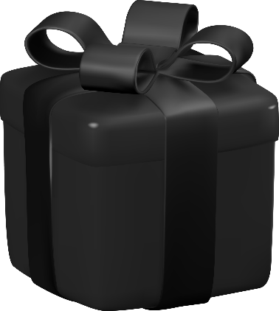
Traditional research approach
The researcher decides:
What is a good RQ
What is a good way to test
What is a convincing argument
A trust-based process
Publication as end-point
@yganko at www.vecteezy.com
Notes:
No post-publication moderation, article seen as beyond reproach
This have led to all the issues we saw at the preceding slide
Does not appear to work to satisfaction

Slide 6

Traditional publication model
Multiple revision rounds
Multiple journal attempts
Unpredictable publication pipeline (and outcome)
Hard to get good peer reviewers
Feedback when it’s too late to make changes
Tax-paid work for commercial entities
Work as authors
Work as reviewers
Work as editors
Author processing charges
University subscriptions
No guarantee for research quality
@eugenia / unsplash.com

Slide 7
Downsides to journal publications
Slow process (some issues are time-sensitive, want to add to ongoing debates, aim to make research public)
Resource cost for reviews and revisions (for authors, reviewers, and editors)
Published articles (or number of pages) claimed to be a limited resource
Peer-reviews (and journals) are of varying (and unknown) quality
Old boy’s club regime (evaluates by “prestige” of authors and institutions)
Published paper seen as being above criticism
Does not guarantee research quality (replication rates are low)
Publication bias (journal preference for some types of findings)
File-drawer effect (authors chose not to publish some research)
Paywalled product (limits the readership)
A for-profit entity claims ownership to the product (tax-payers pay for the work of authors, reviewers, editors, and libraries)
Notes:
Kun kuttes, delvis dekket i forrige og påfølgende lysbilder
Publication bias → Perverse incentives (what are journals interested in publishing?)

Slide 8
Preregistration
Hypothesis development
Design study
Collect data
Analyze data
Interpret results
Disseminate
Declaring what the study will do:
What is the hypothesis,
Which method will be used,
How will it be analysed,
What will we consider important
Leads to:
Honest reporting / tied hands
Transparency / trust, accountability
Provides structure, a research plan, reproducible results
Pre-registration
Notes:
Gjør det tydelig om det er utforskende eller bekreftende forskning
Kaplan & Irving (2015) (i medisin):
Før preregistrering var påkrevd, viste 17/30 studier en signifikant effekt (sikkert større i psykologi)
Etter at det ble påkrevd, falt dette til 2/25

Slide 9
The preregistration revolution
In 10 years:
From being a curiosity…
To be an expectation (when hypothesis testing)
Non-registered research viewed with suspicion?
Remaining challenges
Publication bias
Research waste
Pipeline bottlenecks
Research ownership
Nosek et al. (2018). The preregistration revolution. PNAS, 115(11).

Slide 10
Unresolved issues
«Good» results are easier to publish
Incentives → Questionable research practices
Incentives ≠ Research quality
Issues with preregistrations
Study is not necessarily completed
Study is not necessarily published
Preregistrations are seldom 100% followed
Readers do not check preregistration
Fundamental issue remains:
Researchers doing their best to examine an issue…
…and decide what and how to publish…
Can lead to hundreds of supporting studies…
…surviving across decades…
…to later be revealed as a false positive
Example: Ego-depletion theory
Example: Mortality salience

Slide 11
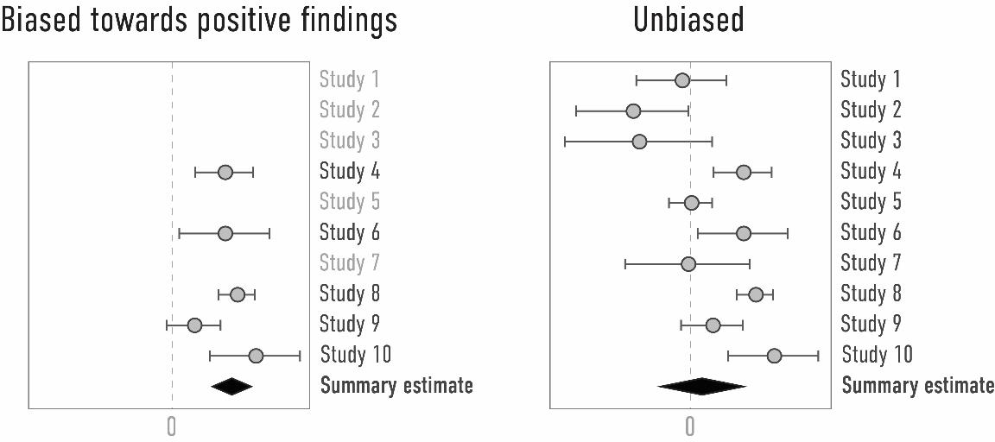
Publication bias
Effect across all performed studies
Effect across the published studies
Results look “unclear”
Contradicts our past findings
Team member does not like results
Need a “strong result” or “a coherent story”
Uncertain about aspects of research
Journal only accepts “novel results”
Journals require stronger evidence when “going against the grain”
Peer reviewers think result “muddles the water”
Researchers prioritize working on other studies
→ All effects in literature are exaggerated
→ Some effects are false positives
https://www.researchequals.com/modules/w0d6-9kwa

Slide 12
What if we had a model that…
Placed a premium on scientific quality
Gave feedback at a useful stage
Had a predictable pipeline
Published all research
Was owned by the community

Slide 13
Registered reports
Hypothesis development
Design study
Collect data
Analyze data
Interpret results
Disseminate
Write stage 1 manuscript:
Introduction + Method
Stage 1 review / revisions
Emphasis on hypotheses
«In principle acceptance»
Perform study
Write stage 2 manuscript:
Results + Discussion
Stage 2 review / revisions
Check if plan was followed
Publication
Stage 2 review
Stage 1 review

Slide 14
Two-step procedure
Write stage 1 manuscript:
Introduction + Method
Peer review
Emphasis on hypotheses
Review rounds
«In principle acceptance»
Perform study
Write stage 2 manuscript:
Results + Discussion
Reviewed for adherence (not results)
Publication

Slide 15
Advantages to registered reports
Decision to publish is independent of findings
Same advantages as preregistration
In addition:
Researchers get usable feedback
Avoids publication bias

Slide 16
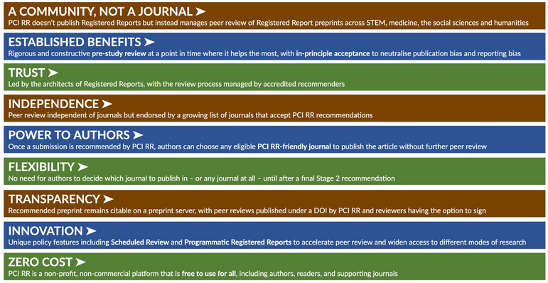
Approach overview
Two models:
Handled by journal (original model, now less popular)
Handled by «peer community in registered reports»
Submission is assigned a “recommender” (an editor)
Finds reviewers, supervises process
Writes “a recommendation” at end
Stands as guarantor for the research
Scheduled review (optional)
Submit «snapshot»
Recommender finds reviewers that commit to a schedule
Submit Stage 1
Receive feedback within 2 weeks
Deadline for performing study
Kiyonaga, A., & Scimeca, J. M. (2019). Practical considerations for navigating registered reports. Trends in neurosciences, 42(9), 568-572.

Slide 17
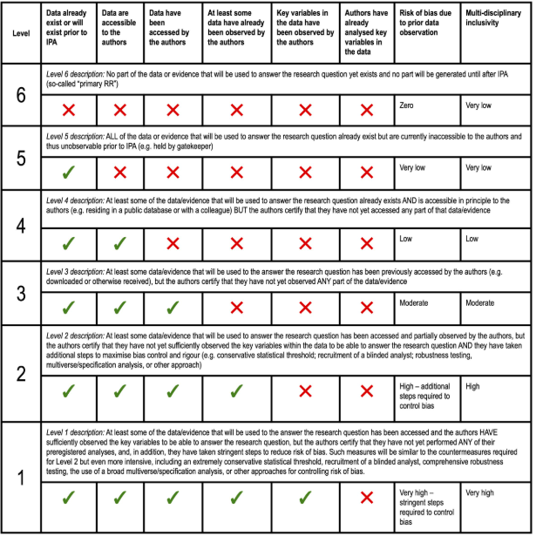
Levels of prior knowledge
The “optimal” RR reaches stage 1 registration before starting data collection
Also possible when you have some knowledge of the data
Needs compensatory measures
May limit publication venues

Slide 18
RR study design table (with nonsense example)
Question | Hypothesis | Sampling plan | Analysis plan | Rationale for test sensitivity | Interpretation given different outcomes | Theory that could be proved to be wrong
Is language processing lateralized? | H1: Preference for right ear stimuli for syllables | We will recruit 80 student participants, randomized into three experiment conditions… | T-test # responses matching left stimuli to matching the right stimuli (p< .05) | We did a power analysis in G*Power for in order to find effects of a magnitude… The smallest effect of interest was… | A positive results indicates a mechanism for… | Lateralized language function in human brain (REF).
 | H2: Intrusions from left ear |  | Chi-square number of errors between conditions (p< .05) |  | A positive results indicates a mechanism for…
Can attention be controlled? | H3: Attention can be directed |  | Chi-square # reports from each ear between conditions (p< .05) |  | A positive results indicates a mechanism for… | The theory of selective auditory attention (REF).
 | H4: More difficult when stimuli are… |  | t-test # errors between conditions (p< .1) |  | A positive results indicates…

Slide 19

Where have RRs been published?

Slide 20

Publishing RR in traditional journals
Currently 281 journals
Journal name less important
Profit / Not for profit
Diamond OA / Gold OA / hybrid
Varies in expectation of prior knowledge
Evaluation:
Auto-accept
Answer within 5-7 days
Considers PCI evaluation
Notes:
Journals may reach out
https://simplewordcloud.com/

Slide 21
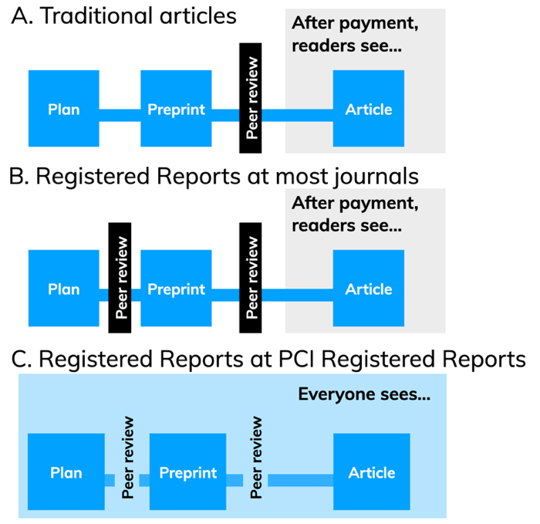
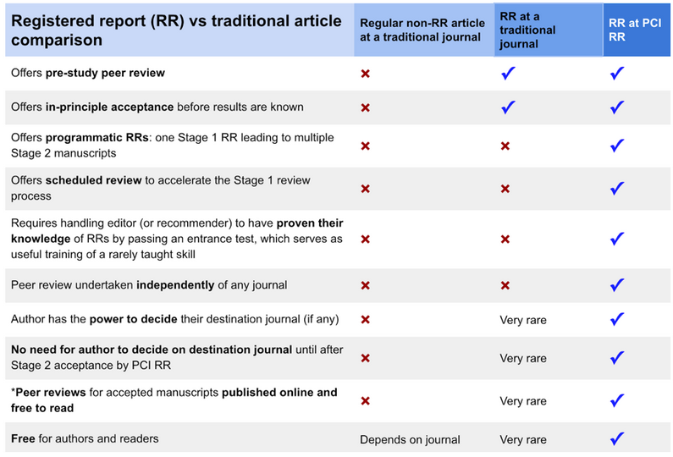
«Peer community in registered reports» journal

Slide 22
Self-interested advantages to RR
Get feedback when it can be used
Less pressure for exploratory analyses
Less focus on alternative explanations
Less concern about outcome
Predictable publication pipeline
Feasible for PhD candidates?

Slide 23
Does RR take more time?
Traditional approach
RR approach
Plan
Plan
Perform
Perform
Writing I&M
Writing I&M
Writing R&D
Writing R&D
Revision 1
Revision 1
Revision 2
Revision 2
New journal

Slide 24
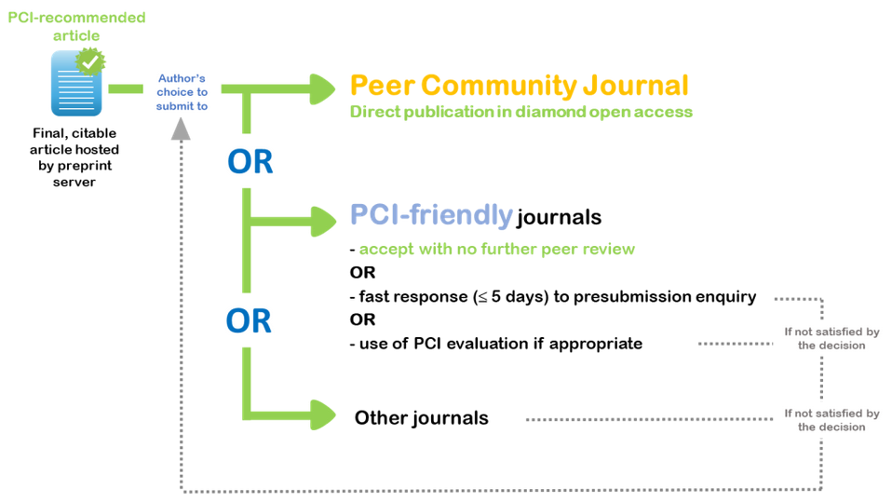
Current status for RRs
Increase in RR publications (numbers)
PCI RR
101 «PCI friendly» journals
Journals may contact author to suggest publishing
Moves power from publishers (and editors) to the peers
Funders dedicating funds to RR
Gold standard for publishing in the future?
Notes:
Better return on investment for funders
https://peercommunityin.org/pci-friendly-journals/

Slide 25
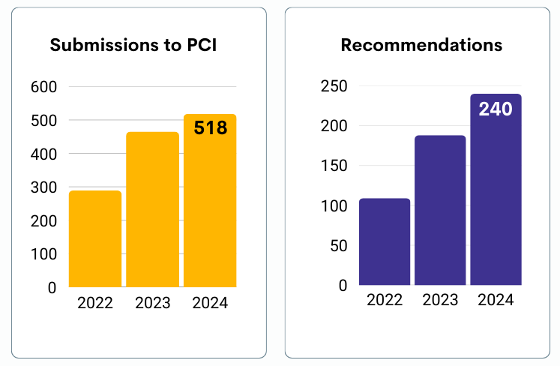
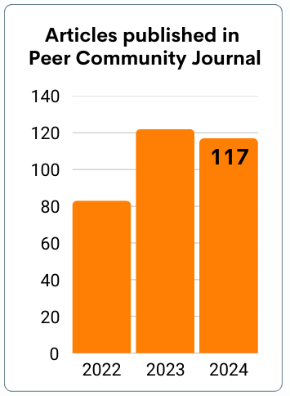

Slide 26
Relevant for you?
Some research funding is dedicated for RRs
Could you plan your next (hypothesis-testing) study as an RR?
Contribute as an RR reviewer?
Contribute as an RR recommender?
Read RRs!

Slide 27
A Multilab Replication of (…) Cognitive Dissonance
Vaidis, D.C., Sleegers, W.W.A., Leeuwen F, DeMarree K.G., Sætrevik, B., (…) Priolo, B.
Notes:
108 authors

Slide 28

A core psychological theory
Lewin’s field theory (1935-1951):
You are a combination of all your experiences
Pushes and pulls on social navigation
Mentored Festinger
Festinger, Riecken & Schachter (1956):
Festinger (1957): A theory of cognitive dissonance
An uncomfortable state
Motivates for consistency
A general human desire for consistent cognitions
A “motivational theory”
Integrated into other theories
Accounts for confirmation bias
A general model for how the mind works
Notes:
“field theory” inspirert fra fysikken
Skjult, deltakende observasjon

Slide 29
Cognitive dissonance mechanism
See ourselves acting against attitudes
Creates dissonance
→ Attitudes are changed
But only when action is voluntary!
I like animals
Change attitude: “This animal had a good life”
Dissonance!
Justify / low choice: “Nothing else on the menu”
I eat meat
Change action: “I should stop eating meat”
Notes:
A motivational theory
Festinger, 1957

Slide 30
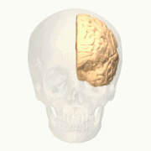
Cognitive dissonance application
Education
Social behaviour
Political psychology
Persuasion
COVID-19 compliance
Psychotherapy
Suggested as model for “strong AI”
Competing theories
Self-perception theory
Balance theory
Cost–benefit analysis
Self-discrepancy theory
Notes:
Don’t reward intrinsically rewarding tasks
Make pro-social attitudes prominent. Hostile actions lead to hostile attitudes.
Defend the politician you voted for
Paths to persuation
- Remind people of what they believe to be true
General effect of psychotherapy

Slide 31
CD experimental paradigms
Free-choice paradigm
Make a tough decision between two moderately and appreciated options
How much did you like the chosen and the non-chosen option?
“Spreading of alternatives” effect
Most / cross-cultural research uses this
Methodological weaknesses
Induced compliance paradigm
Perform a task that is consistent or inconsistent with attitudes
Manipulate the ability to justify performance
A: Task consistent with attitudes
Manipulate reward
If you got a reward, maybe you didn’t really like it?
Reduces (positive) attitude
B: Task inconsistent with attitudes
Manipulate perceived free will
If you could have chosen not to, maybe you didn’t dislike it?
Reduces (negative) attitude
Notes:
“spreading of alternatives”: try to reduce this discomfort by evaluating chosen options more favorably and/or evaluating unchosen options less favorably

Slide 32
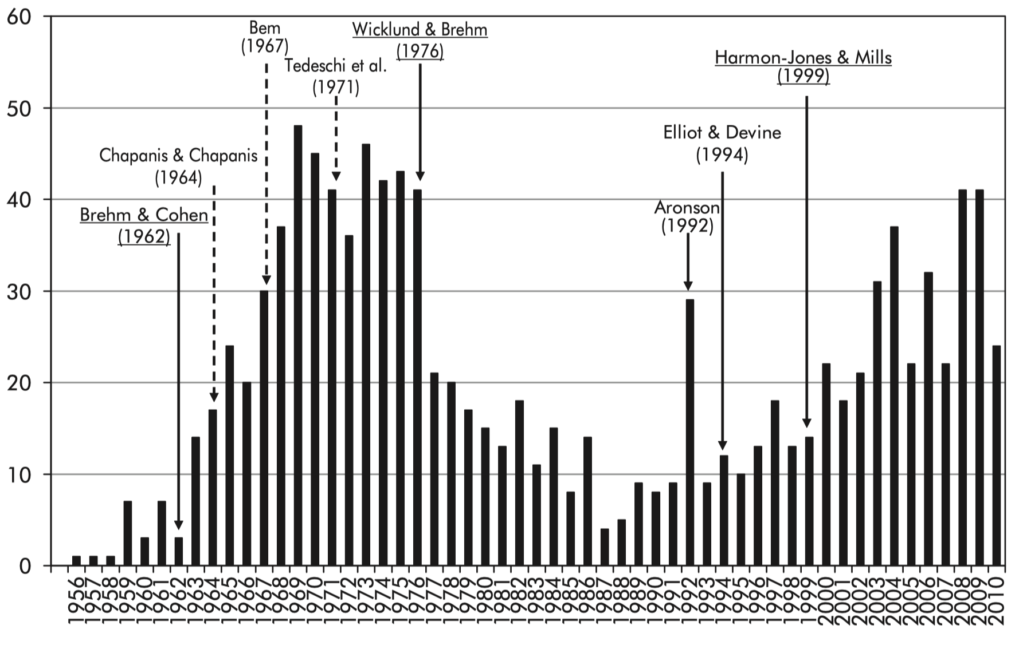
Why do an RR replication (RRR)?
A fundamental effect in psychology
One of the most influential theories
Mentioned in textbooks and in popular psychology
Relevant for wide range of behaviours
Lots of prior research
Samples are mostly small (n < 20)
Implausibly large effects (d = 2.4)
No double-blind designs, poor control
No standard experiment procedure
A “constructive replication” of classical study (Cooper & Croyle, 1983)
Why do it as a registered report?
Make a seminal replication
Take all possible arguments into account
Number of publications
Notes:
A motivational theory

Slide 33
Experiment design
A “many labs” approach: 39 labs, 19 countries, 4,898 participants, 108 authors
In-person (lab) experiment using Qualtrics, data stored centrally
No mention
Argue for tuition raise
Pilot
attitudes
measure
Attitude
about
tuition
Rando-mize
Attitude
about
tuition
Sign agreement
Argue for tuition raise
No mention
Neutral writing task
For most labs:
“Raise the tuition”
Conditions
HC-CE: Perceived high-choice for writing counter-attitudinal arguments
LC-CE: Perceived low-choice for writing counter-attitudinal arguments (choice control)
HC-NE: Perceived high-choice for writing neutral writing task (inconsistency control)
Experimenter
blinded
Notes:
Pre/post test “Induced compliance paradigm”
High-choice: A reminder that writing the essay is voluntary:
“Because this survey is part of a research project, we want to remind you that your participation is completely voluntary. We would appreciate your help, but we do want to let you know that it's completely up to you.”
Resulting in an internal attribution (“I decided to write arguments in favor of this bad idea”)

Slide 34
Study design
“Induced compliance paradigm”
Pre-test measure of attitude
Argument-writing task
Measure attitude
Attitude:
Pilot to find reasonable target attitude
For most: “Raise the tuition”
Conditions
HC-CE: Perceived high-choice for writing counter-attitudinal arguments
LC-CE: Perceived low-choice for writing counter-attitudinal arguments (choice control)
HC-NE: Perceived high-choice for writing neutral writing task (inconsistency control)
Experimenter blinded to HC-CE vs. HC-NE
In-person (lab) experiment using Qualtrics, data stored centrally
A “many labs”-approach: 39 labs, 19 countries, 4,898 participants, 108 authors
Notes:
High-choice: A reminder that writing the essay is voluntary:
“Because this survey is part of a research project, we want to remind you that your participation is completely voluntary. We would appreciate your help, but we do want to let you know that it's completely up to you.”
Resulting in an internal attribution (“I decided to write arguments in favor of this bad idea”)

Slide 35
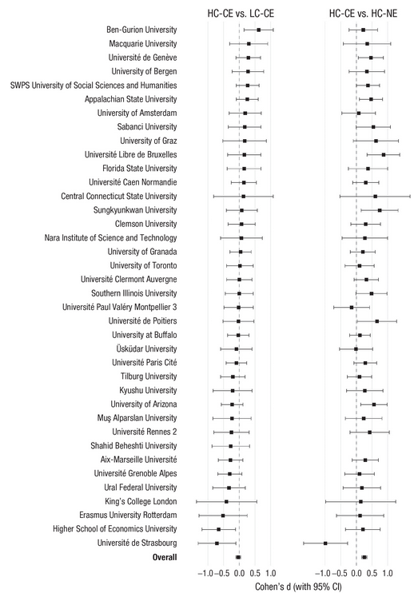
Results
A successful large-scale data collection
Manipulation check successful
Attitude change after writing counter-attitudinal essay t(1,725.20) = 6.72, p < .001, d = 0.31
But perceived choice did not have any effect! (t(1,969.56) = 0.38, p = .35, d = 0.017)
Robust to data exclusions, lab variability, and attitude assessment
Cognitive dissonance appears to be real…
But perhaps not due to the normally assumed mechanisms / methods

Slide 36

Registered report timeline
2018: Project initiated
2019: Researcher recruitment at SIPS
Discussion, choose paradigm and design
2020: Stage 1 manuscript first review:
Extensive methodological changes
Moderating expectations / conclusions
2020: Stage 1 manuscript second review:
Two minor methodological changes
→ “In principle accepted”
2020-2022: Data collection (under COVID)
2023: Stage 2 review:
Reviewers agreed that the plan had been followed
Phrasing of the conclusion, checking some alternative explanations
One reviewer now tried to raise post-hoc issues with study design
2024: Published
Notes:
3 reviewers (one named?)
Active editor
Stage 1:
Simplified the design and improved the procedure
>1 week delay between pre-test and main experiment
Stage 2:
“I reviewed the stage 1 manuscript and I found this stage 2 version to adhere extremely well to the registered hypotheses and procedures, to properly justify informative exploratory analyses, and to provide largely fitting conclusions.”

Slide 37




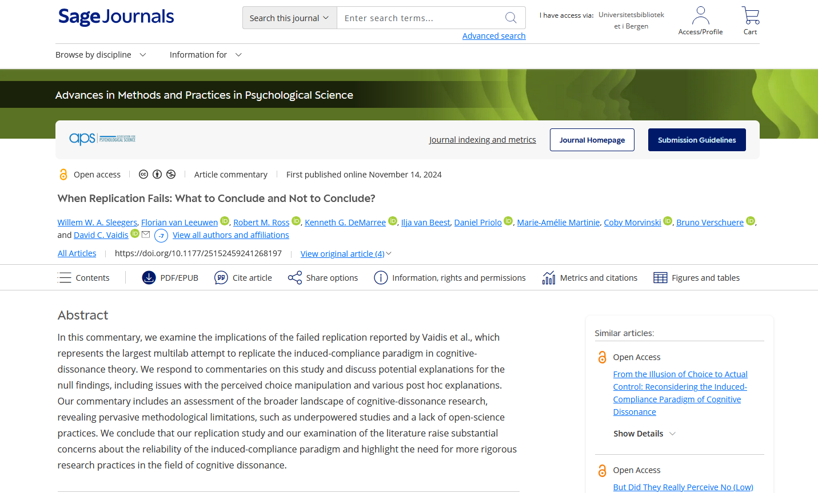
Status
Published February 2024: Vaidis et al.: “A Multilab Replication of the Induced-Compliance Paradigm of Cognitive Dissonance” in “Advances in Methods and Practices in Psychological Science”
Four commentaries November 2024:
Lishner: “But Did They Really Perceive No (Low) Choice?”
Cyrus-Lai, Tierney, & Uhlmann: “Noise Versus Signal: What Can One Conclude When a Classic Finding Fails to Replicate?”
Harmon-Jones & Harmon-Jones: “Dissonance in the Induced-Compliance Paradigm”
Sleegers et al.: “When Replication Fails: What to Conclude and Not to Conclude?”

Slide 38

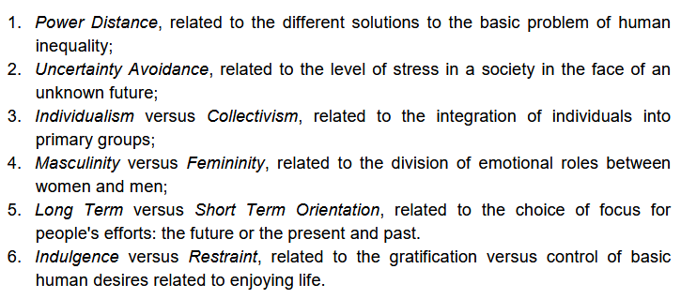
Further work: Variability in CD
Why did our RRR show the predicted pattern?
Freedom of choice influence not supported
People may vary on their “baseline” ways of thinking about choice, freedom, responsibility
Intra-cultural and inter-cultural variation
Large dataset with similar set-up allows us to explore this
Individual variation in self-construal
People define themselves in terms of stable, internal attributes
Vs.: People define themselves in terms of relationships to others
Cultural differences in individualism
18 countries
Cultures see behaviour as resulting from individual decisions
Vs.: Cultures see behaviour as resulting from group pressures
Hofstede, G. (2011). Dimensionalizing cultures
Notes:
e.g. Canada vs. Japan

Slide 39
Cross-cultural CD
Cross-cultural comparisons
Tend to compare two countries assumed to be high/low
Tend to not measure cultural effects individually
Only 1/43 studies sufficiently powered
Notes:
80% power to detect d = 0.4

Slide 40
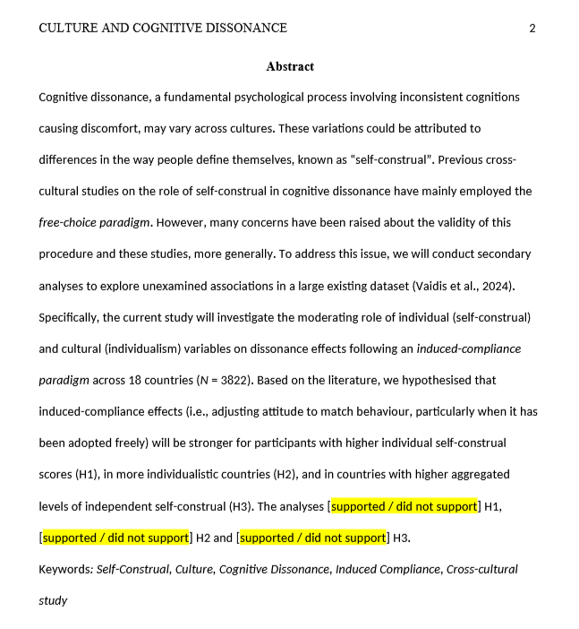
Further work: Variability hypotheses
Hypotheses:
H1: More attitude-change for independent (as opposed to interdependent) self-construal
H2: More attitude-change in individualistic countries (Hofstede index)
H3: More attitude-change in countries with on average more independent self-construal
Currently a stage 1 RR: https://osf.io/preprints/psyarxiv/fk3pd

Slide 41
Our general RR experiences
Different from “business as usual”
More “front-loading” of the research process
Feels like the way research should be done!

Slide 42

For more on such issues…
We have a monthly ReproducibiliTea journal club
Early career and senior members
Credited as a 1 ECST PhD course
Contact me to join the ReproducibiliTeaM

Slide 43


